Slide 1


Jonas Fockstedt
2022-07-24

Slide 2

Outline
Executive Summary
Introduction
Methodology
Results
Conclusion
Appendix

Slide 3
Executive Summary
Data was collected via publicly available data sets
The data was analyzed with a variety of different methods
The results point to that in order to maximize a successful outcome of a mission, one should use
Launch site KSC LC-39A
The FT booster
Have a payload between 2000kg and 6000kg

Slide 4
Introduction
SpaceY
New space startup
Needs to be competitive with SpaceX
Main question – will SpaceX reuse the first stage of the Falcon 9 rocket?

Slide 5

Section 1

Slide 6
Methodology
Executive Summary
Data collection methodology:
Data was collected via publicly available datasets
Perform data wrangling
Data was processed using Python and the Pandas library
Perform exploratory data analysis (EDA) using visualization and SQL
Perform interactive visual analytics using Folium and Plotly Dash
Perform predictive analysis using classification models
How to build, tune, evaluate classification models

Slide 7
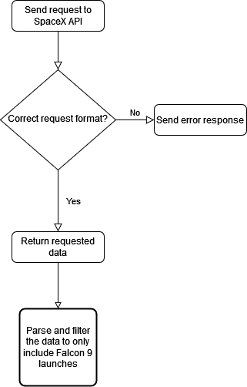
Data Collection – SpaceX API
Using the requests library for Python, the data was collected via API calls to the appropriate address
The flow of the process is shown in the flow chart
Notebook

Slide 8
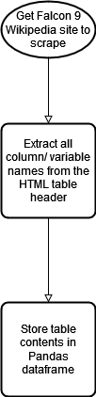
Data Collection - Scraping
Additional data needed to be collected from the Wikipedia site, in a table containing information of the F9 rocket
The webscraping was done using BeautifulSoup library in Python
The different steps are displayed in the flow chart
Notebook

Slide 9
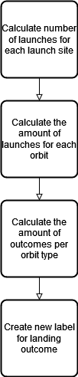
Data Wrangling
Describe how data were processed
Data was processed by doing calculations for each launch site as well as orbit type
The workflow is depicted in the flow chart
Notebook

Slide 10
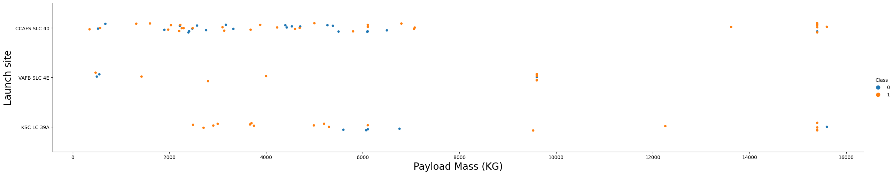
EDA with Data Visualization
To get a better understanding of the relationship between different variables, scatter plots were used. These insights would lead to a better understanding of important variables
Below plot shows the relationship between payload mass and launch site, and whether the launch was successful or not (0=unsuccessful, 1=successful)
Add the GitHub URL of your completed EDA with data visualization notebook, as an external reference and peer-review purpose
Notebook

Slide 11
EDA with SQL
SQL queries were performed where which in summary extracted data of which
Which launch site had the most successful amount of landings
Which booster version had carried the maximum payload mass
Notebook

Slide 12
Build an Interactive Map with Folium
The objects added to the Folium map were
Circles, Markers, PolyLines, Mouse position
These objects where necessary to add in order to mark out where the different launch sites are located on the world map as well as display information about the different launch sites. This information includes the amount of successful and unsuccessful launches the corresponding launch site had
Notebook

Slide 13
Build a Dashboard with Plotly Dash
The Plotly Dashboard has a drop-down menu, pie chart, range slider, and a scatter plot
The drop-down menu works as an interactive way of filtering the data displayed in the pie chart, which in turn shows the amount of successful and unsuccessful launches for each site. The range slider determines what payload mass should be displayed in the scatter plot, which shows the payload mass vs the success of a given launch
SpaceX Dash App

Slide 14
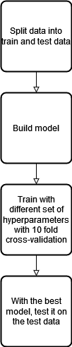
Predictive Analysis (Classification)
Summarize how you built, evaluated, improved, and found the best performing classification model
The different classification models used were developed with the Scikit learn library for Python. They were all trained with grid search where a number of different hyperparameters were tried out, with a cross-validation fold of 10. The best performing model among the given hyperparameters was later evaluated on the test set (20% of the original dataset, 80% for training and validation)
The models that were tested were logistic regression, decision tree, svm, and KNN
Notebook

Slide 15

Section 2

Slide 16
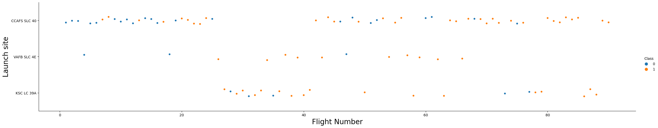
Flight Number vs. Launch Site
A scatter plot for the Flight Number vs Launch site is shown:
From the plot, one can conclude that all launch sites have higher success rate (class=1, unsuccessful = class 0) as the number of flights from that launch site increases.
Launch site KSC LC 39A shows the highest landing success rate (77%)

Slide 17
Payload vs. Launch Site
Class = 0, unsuccessful landing, class = 1, successful landing
The scatter plot shows the relationship between the success of a given launch site with a given payload. It tells that the success rate is generally higher for heavier payloads.
Launch site KSC LC 39A shows a higher overall success rate (76%)

Slide 18
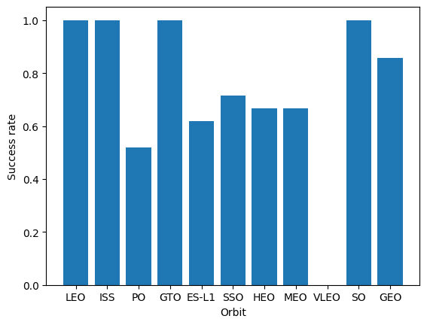
Success Rate vs. Orbit Type
The bar chart shows the success rate for each orbit type
LEO, ISS, GTO, SO all have 100% success rate
VLEO the only orbit with 0% success rate

Slide 19
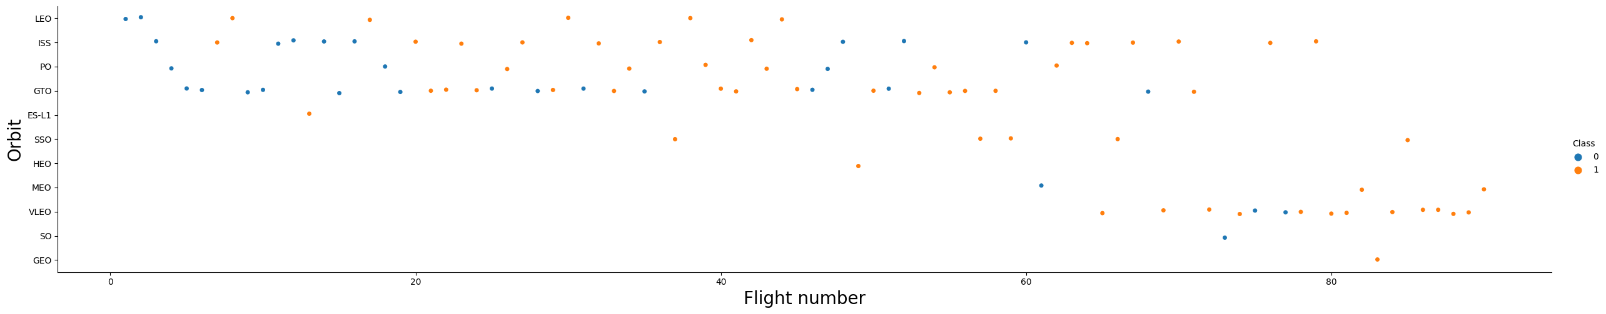
Flight Number vs. Orbit Type
Successful landing = Class 1, unsuccessful landing = Class 0
The general trend shows a higher success rate as the flight number increases for all orbit types

Slide 20
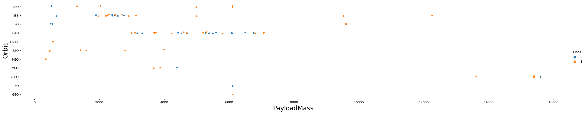
Payload vs. Orbit Type
Successful landing = Class 1, Unsuccessful landing = Class 0
The VLEO orbit missions are the ones with the highest payload mass for the rocket
SSO, HEO, and GEO orbit all show 100% success rate, despite having different payload masses

Slide 21
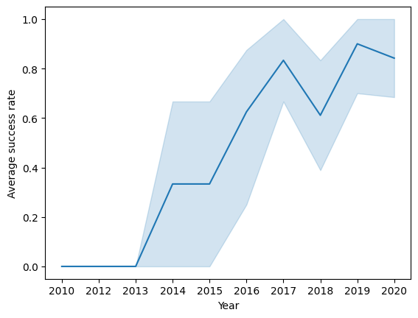
Launch Success Yearly Trend
The plot shows the average success rate for a given year
After 2013, the trend steadily increases

Slide 22
All Launch Site Names
The names of the unique launch sites are displayed in the table
Launch sites
CCAFS LC-40
VAFB SLC-4E
KSC LC-39A
CCAFS SLC-40

Slide 23
Launch Site Names Begin with 'CCA'
The table is the result shown from a query which returns 5 records where the launch site of the mission begins with “CCA”
Date | Time (UTC) | Booster_Version | Launch_Site | Payload | PAYLOAD_MASS__KG_ | Orbit | Customer | Mission_Outcome | Landing _Outcome
04-06-2010 | 18:45:00 | F9 v1.0 B0003 | CCAFS LC-40 | Dragon Spacecraft Qualification Unit | 0 | LEO | SpaceX | Success | Failure (parachute)
08-12-2010 | 15:43:00 | F9 v1.0 B0004 | CCAFS LC-40 | Dragon demo flight C1, two CubeSats, barrel of Brouere cheese | 0 | LEO (ISS) | NASA (COTS) NRO | Success | Failure (parachute)
22-05-2012 | 07:44:00 | F9 v1.0 B0005 | CCAFS LC-40 | Dragon demo flight C2 | 525 | LEO (ISS) | NASA (COTS) | Success | No attempt
08-10-2012 | 00:35:00 | F9 v1.0 B0006 | CCAFS LC-40 | SpaceX CRS-1 | 500 | LEO (ISS) | NASA (CRS) | Success | No attempt
01-03-2013 | 15:10:00 | F9 v1.0 B0007 | CCAFS LC-40 | SpaceX CRS-2 | 677 | LEO (ISS) | NASA (CRS) | Success | No attempt

Slide 24
Total Payload Mass
The table shows the total payload which has been carried by NASA as a customer of SpaceX
Shown in KG
TOTAL_PAYLOAD_KG
45596

Slide 25
Average Payload Mass by F9 v1.1
The table is a result of averaging the payload carried by the F9 version 1.1 booster, shown in KG
AVG_PAYLOAD_KG
2928.4

Slide 26
First Successful Ground Landing Date
The date of the first successful landing on the ground pad is shown in the table
First_Successful_Landing
01-05-2017

Slide 27
Successful Drone Ship Landing with Payload between 4000 and 6000
The table shows the names of the different boosters which has had a payload mass greater than 4000kg and less than 6000kg
Booster_Version
F9 FT B1022
F9 FT B1026
F9 FT B1021.2
F9 FT B1031.2

Slide 28
Total Number of Successful and Failure Mission Outcomes
The table shows the amount of failed and successful mission outcomes, respectively
Successes dominates failures
Failures | Successes
1 | 100

Slide 29
Boosters Carried Maximum Payload
Booster_Version
F9 B5 B1048.4
F9 B5 B1049.4
F9 B5 B1051.3
F9 B5 B1056.4
F9 B5 B1048.5
F9 B5 B1051.4
F9 B5 B1049.5
F9 B5 B1060.2
F9 B5 B1058.3
F9 B5 B1051.6
F9 B5 B1060.3
F9 B5 B1049.7
The table displays the boosters which have carried the heaviest payload mass

Slide 30
2015 Launch Records
The table shows the missions with a failed landing outcome in the year 2015
The month column states the month number (e.g., 01 = January)
Month | Booster_Version | Launch_Site | Landing _Outcome
01 | F9 v1.1 B1012 | CCAFS LC-40 | Failure (drone ship)
04 | F9 v1.1 B1015 | CCAFS LC-40 | Failure (drone ship)

Slide 31
Rank Landing Outcomes Between 2010-06-04 and 2017-03-20
The table shows the records of which occurred between 2010-06-04 and 2017-03-20 and also had a successful outcome, in descending date order
Date | Time (UTC) | Booster_Version | Launch_Site | Payload | PAYLOAD_MASS__KG_ | Orbit | Customer | Mission_Outcome | Landing _Outcome
22-12-2015 | 01:29:00 | F9 FT B1019 | CCAFS LC-40 | OG2 Mission 2 11 Orbcomm-OG2 satellites | 2034 | LEO | Orbcomm | Success | Success (ground pad)
08-04-2016 | 20:43:00 | F9 FT B1021.1 | CCAFS LC-40 | SpaceX CRS-8 | 3136 | LEO (ISS) | NASA (CRS) | Success | Success (drone ship)
06-05-2016 | 05:21:00 | F9 FT B1022 | CCAFS LC-40 | JCSAT-14 | 4696 | GTO | SKY Perfect JSAT Group | Success | Success (drone ship)
27-05-2016 | 21:39:00 | F9 FT B1023.1 | CCAFS LC-40 | Thaicom 8 | 3100 | GTO | Thaicom | Success | Success (drone ship)
18-07-2016 | 04:45:00 | F9 FT B1025.1 | CCAFS LC-40 | SpaceX CRS-9 | 2257 | LEO (ISS) | NASA (CRS) | Success | Success (ground pad)
14-08-2016 | 05:26:00 | F9 FT B1026 | CCAFS LC-40 | JCSAT-16 | 4600 | GTO | SKY Perfect JSAT Group | Success | Success (drone ship)
14-01-2017 | 17:54:00 | F9 FT B1029.1 | VAFB SLC-4E | Iridium NEXT 1 | 9600 | Polar LEO | Iridium Communications | Success | Success (drone ship)
19-02-2017 | 14:39:00 | F9 FT B1031.1 | KSC LC-39A | SpaceX CRS-10 | 2490 | LEO (ISS) | NASA (CRS) | Success | Success (ground pad)

Slide 32

Section 3

Slide 33
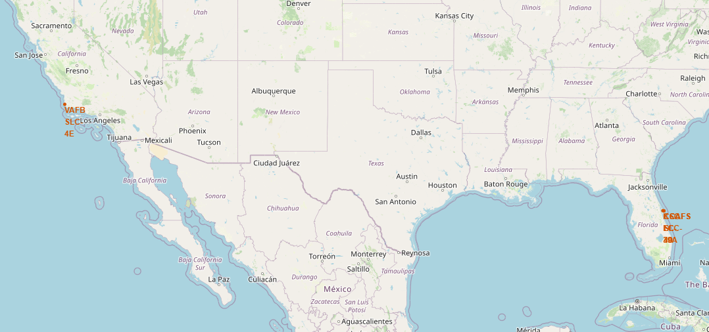
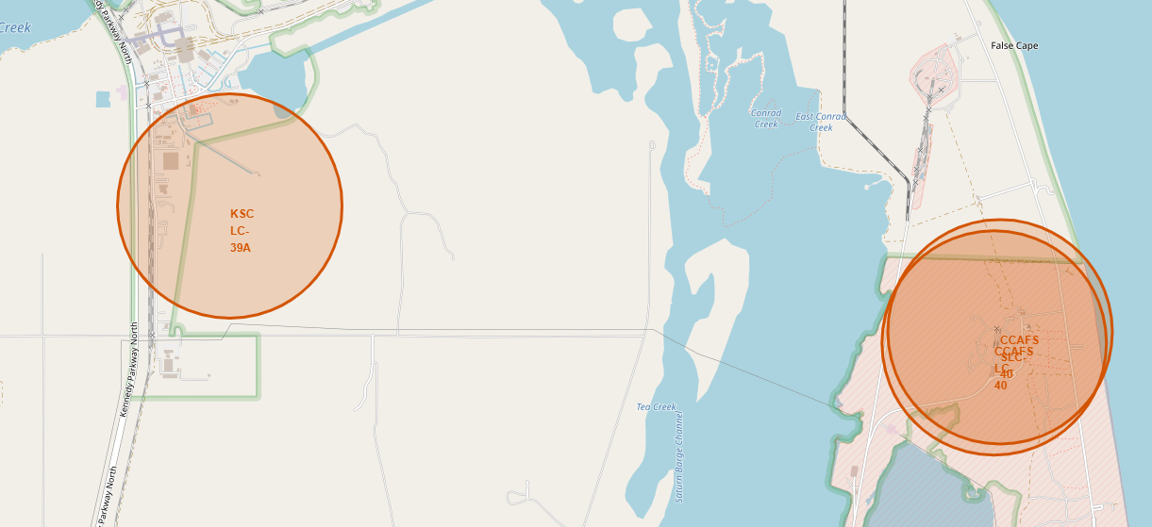
Folium Map – Launch Site Locations
All four launch sites are marked out on the map. Three of them, CCAFS LC-40, KSC LC-39A, and CCAFS SLC-40 are close to each other and therefore are not distinguishable in the zoomed-out view
All launch sites are along the coast of the US

Slide 34
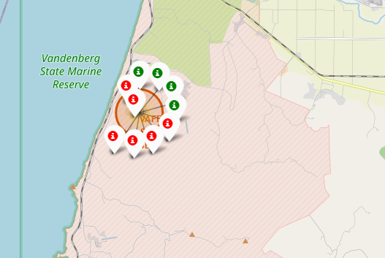
Folium Map – Launch Site Outcomes
The screenshot shows the mission outcomes (successful or unsuccessful landing) for the VFAB SLC-40 launch site
Successful = green
Unsuccessful = red
Gives a quick and easily interpreted overview of the success rate of a given launch site

Slide 35
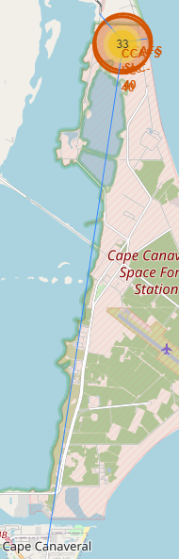
Folium Map – Launch Site Proximities
The screenshot shows the closest relevant resources to the launch site CCAFS SLC-40, drawn with blue lines
Railroad in top left
Coastline in top right
Closest town in bottom
For transportation purposes, the launch site is close to a railway
For safety purposes, the launch site is stationed far away from the closest city and close to a coastline

Slide 36

Section 4

Slide 37
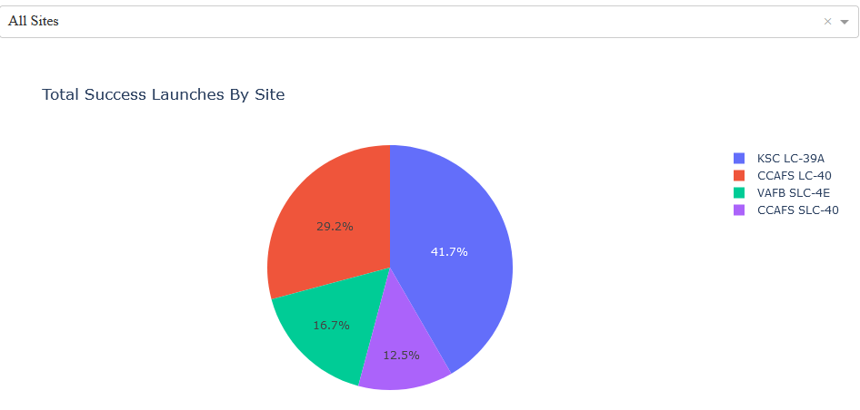
Dashboard – Successful Launches By Site
The pie chart displays the success rate for all of the different launch sites, by all total launches
KSC LC-39A has the highest success rate of 41.7%
CCAFS SLC-40 with the lowest success rate of 12.5%

Slide 38
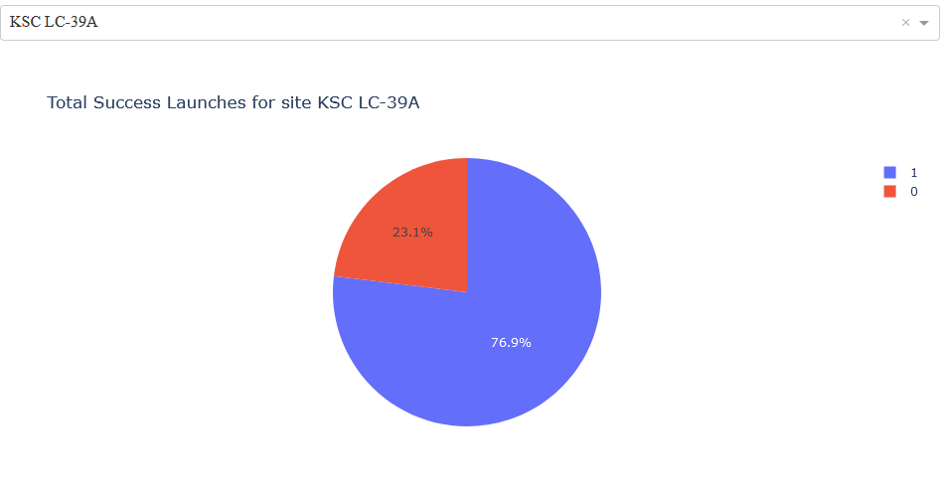
Dashboard – Most Successful Launch Site
The screenshot shows the distribution between successful and unsuccessful launches for the KSC LC-39A launch site
76.9% of the total launches had a successful outcome (label = 1)

Slide 39
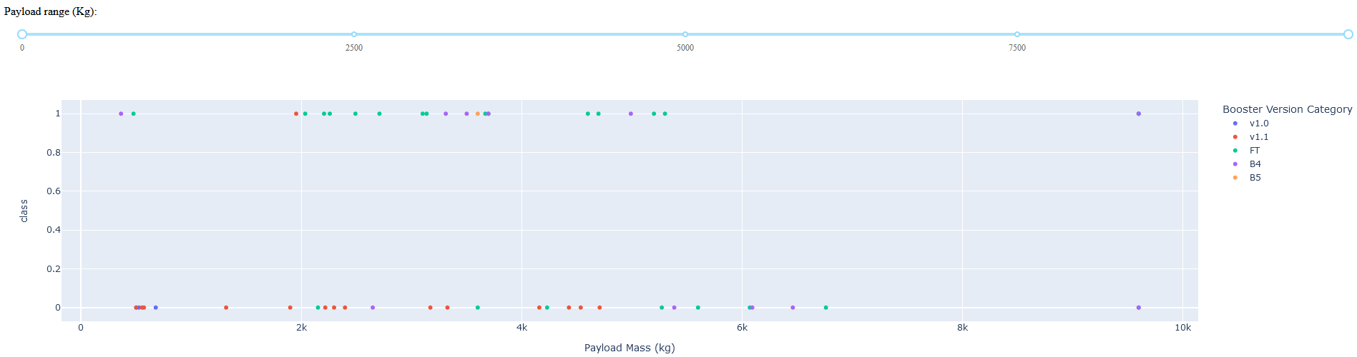
Dashboard – Payload vs. Success Rate For Booster
The screenshot shows the mission outcome for the different boosters for all payload masses (class 1 = successful outcome, class 0 = unsuccessful outcome)
The FT booster shows the highest amount of successful mission outcomes (specifically in the range of 2000kg and 6000kg)

Slide 40
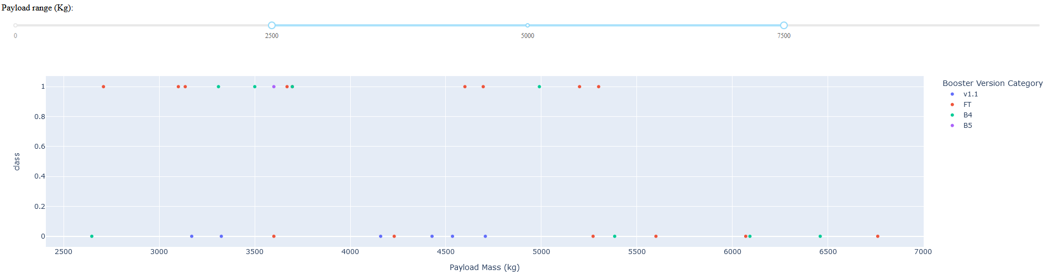
Dashboard – Payload vs. Success Rate For Booster
This screenshot instead shows the mission outcomes for boosters which carried a payload mass between 2500kg and 7500kg
Also shows that the FT booster seems beneficial for a successful mission outcome

Slide 41

Section 5

Slide 42
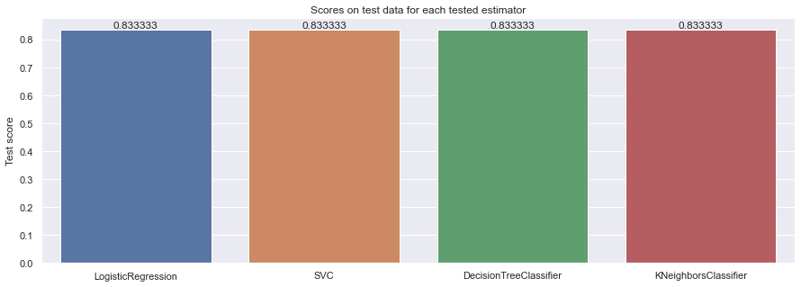
Classification Accuracy
The bar chart shows the score on the test set for the four different ML models
All models performed equally as good on this test set

Slide 43
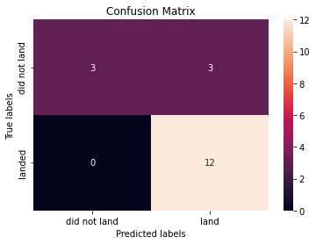
Confusion Matrix
Since all models performed the same on the test set, the confusion matrix represents the performance of all models
All predictions of a positive landing outcome were correct (100% recall rate)
The false negatives and true negatives showed a 50% accuracy respectively
The most important prediction to accurately predict is whether the mission will have a positive outcome

Slide 44
Conclusions
Seems to be important for a launch site to be close to the coast, railway for transportation of the rocket itself, and to have good distance from closest city
According to the data, launch site KSC LC-39A is the site to pick in order to have the highest probability of a successful mission outcome
Best to pick a payload between 2000kg and 6000kg
Use the FT booster since it has a historical record of the most successful mission outcomes
The LEO, ISS, GTO, and SO orbit types all have a 100% success rate
The data set is probably too small in order to draw any major conclusions from a machine learning perspective, as the different models tell the same story
But the models are 100% sure when the mission will have a successful outcome

Slide 45
Appendix - Notebooks
SpaceX API notebook
Webscraping notebook
Data wrangling notebook
EDA Data visualization notebook
EDA SQL notebook
Launch Sites Location Analysis notebook
SpaceX Dash App
Landing Prediction notebook

Slide 46


